Slide 1

Family Business Symposium
University of Western Australia
September 25-27, 2018

Slide 2
Introduction
Peter Goldschmidt
  B.Sc. from California State University (Business Administration; M.Ec. (Applied Econometrics); and Ph.D. (Computer Science and Finance) from The University of Western Australia.
  His Ph.D. dissertation was awarded the 1997 International Outstanding Doctoral Dissertation Award from the American Accounting Association.
  Active in academia, industry, business, government, and international organisations as a researcher, adviser and consultant.
  Professor in Information Management at UWA Business School, working in Knowledge Management, Decision Support, Agent Technology, e-Commerce, Artificial Intelligence Applied to Business, Compliance Infrastructure and Asset Management work flow decision support.
  Developer of a new approach supporting Compliance Monitoring for Anomaly detection (CMAD). The approach is suitable for complex environments, such as stock stock market surveillance, energy and petroleum industry; engineering; aerospace and defence.
Arthur Wilson (Speaker)
  Masters from The University of Western Australia (Information Management).
  Current PhD student at Curtin University focused on transforming community engagement through the use of digital technology.
  Experienced in governance, strategy and policy and IS/IT, project and portfolio management, process reengineering, and service delivery transformation.
  Active in academia, business, defence, government.
  Invited by multiple Western Australian agencies to lead complex and significant initiatives involving transformation service delivery.

Slide 3
Introduction
This presentation presents potential challenges encountered by family businesses when adopting digital technologies to transform aspects of their enterprise.
Notes:
In Association of Southeast Asian Nations (ASEAN)

Slide 4
Introduction
Family business comprise of 70% of Australian businesses and important to the economy (Barrett, 2013; Ward, 2016)
In ASEAN, it is estimated digital economy will grow to US$200 billion by 2025 (Hong, 2017)
Digital technology also impacts family businesses

Slide 5
Method
A review of academic literature
Actor-network theory (ANT) as its methodological lens
Henderson and Venkatraman (1993) Strategic Alignment Model (SAM) was identified as a seminal body of work for aligning an organisation’s business and technology strategies (Coltman et al., 2015)

Slide 6
Findings
Influence of digital technologies is significant:
  Impacts people, organisations, and communities (Beckers & van den Besselaar, 2014)
Digital technologies foster transformation:
  Social, economic, and political environments; personal and professional relationships; and impacts living standards (Brynjolfsson & Hitt, 2000; Rauniar, Rawski, Yang, & Johnson, 2014)
Rapid technological change is:
  Impacts business strategy, investment decisions, service delivery, and how it competes (Hong, 2017)

Slide 7
Findings: Areas of service impact
Digital technologies impact multiple areas of a family business:
  Customer engagement, including through social media, and online communities
  Business transactions
  Provision of services online
  Data analytics
  Knowledge management
  (Hong, 2017)

Slide 8
Findings: Challenges
Digital technology:
  Initial success can be elusive (Baxter & Sommerville, 2011; Bloch et al., 2011)
  Failure rate exceeds 60% (De Waal, van Outvorst, & Ravesteyn, 2016; Pflügler et al., 2018)
  5,400 IT projects: Over $66 billion in cost overruns (Bloch et al., 2011)
  Correcting software due to poor functional and business requirements exceeds $45 billion annually (Pimchangthong & Boonjing, 2017).

Slide 9
Findings: Challenges
Risk | Domain | Ref
Insufficient commitment | Leadership | Alvesson and Sveningsson (2015), Frost, 2014
Failure to transform culture, including multidisciplinary matters | Leadership and culture | Frost, 2014, Lawrence (2015); South and Phillips (2014)
Poor design and implementation | Process | Frost, 2014
Complexity | Leadership and Management | Cresswell and Sheikh (2013)

Slide 10
Family business leadership challenges
Concern
64%
‘Going digital’ is a top concern of family business
Significance
Impact of going digital not understood
75%
Competence
Lack of a strategy and expertise to implement
63%
(Hong 2017)

Slide 11
Discussion
Systems often fail because more attention allocated to technical consideration, less focus on non-technical, and social impacts (Spector & Wang, 2002; Tatnall & Gilding, 1999).
Even with implementing state-of-the art technology, success may be elusive because social aspects were not adequately considered leading to customer dissatisfaction (Baxter & Sommerville, 2011).

Slide 12
Discussion: Make it simple
Align vision, strategy, and technology
Multiple social and technical issues interact
Different areas of business can have the power to lead at different stages within digital initiatives.
Digital transformation is complex. A framework can help make it less complex

Slide 13
Discussion: Lacking suitable framework
According to Hossan (2015), the lack of frameworks that help guide change is a reason for approximately 70% of public sector transformation initiatives fail.

Slide 14
Managing Complexity
Customer
Leadership & Management
Culture
Process
Technology

Slide 15
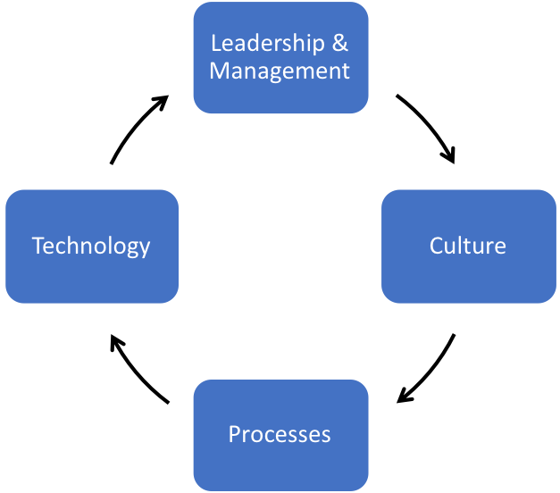
Managing Complexity
Proposed Initiative

Slide 16
Discussion: No magic. Dedication. Focus.
Initiatives that transform take time (Fung, 2015).

Slide 17
References
Alvesson, M., & Sveningsson, S. (2015). Changing organizational culture: Cultural change work in progress, culture defined. New York, NY.: Routledge.
Baxter, G., & Sommerville, I. (2011). Socio-technical systems: From design methods to systems engineering. Interacting with Computers, 23(1), 4-17.
Barrett, M. A. (2013). Family enterprise: Significant and different. In: Taylor & Francis.
Beckers, D., & van den Besselaar, P. (2014). The tales of the three digital cities of Amsterdam: The application of ICT for social and political participation. Histories of media (ted) participation, 105.
Bloch, M., Blumberg, S., & Laartz, J. (2011). Delivering large-scale IT projects on time, on budget, and on value. Harvard business review.
Brynjolfsson, E., & Hitt, L. M. (2000). Beyond computation: Information technology, organizational transformation and business performance. The Journal of Economic Perspectives, 23-48.
Coltman, T., Tallon, P., Sharma, R., & Queiroz, M. (2015). Strategic IT alignment: twenty-five years on. Journal of Information Technology, 30(2), 91-100.
Cresswell, K., & Sheikh, A. (2013). Organizational issues in the implementation and adoption of health information technology innovations: an interpretative review. International journal of medical informatics, 82(5), e73-e86.
De Waal, B., van Outvorst, F., & Ravesteyn, P. (2016). Digital leadership: The objective-subjective dichotomy of technology revisited. Paper presented at the 12 th European Conference on Management, Leadership and Governance ECMLG 2016.
Frost, A. (2014). A synthesis of knowledge management failure factors. Recuperado el, 22.

Slide 18
References
Henderson, J. C., & Venkatraman, N. (1993). Strategic alignment: Leveraging information technology for transforming organizations. IBM systems journal, 32(1), 4-16.
Hong, C. W. (2017). Family Businesses in the Digital Economy. Retrieved from Singapore:
Hossan, C. (2015). Applicability of Lewin’s change management theory in Australian local government. International Journal of business and Management, 10(6), 53.
Pflügler, C., Malzer, T., Jäschke, T., Wiesche, M., & Krcmar, H. (2018). "Do I want to have losers in my team?"-A quantitative study of learning from IT project failure. Paper presented at the Proceedings of the 51st Hawaii International Conference on System Sciences.
Pimchangthong, D., & Boonjing, V. (2017). Effects of risk management practices on IT project success. Management and Production Engineering Review, 8(1), 30-37.
Rauniar, R., Rawski, G., Yang, J., & Johnson, B. (2014). Technology acceptance model (TAM) and social media usage: An empirical study on Facebook. Journal of Enterprise Information Management, 27(1), 6-30
South, J., & Phillips, G. (2014). Evaluating community engagement as part of the public health system. J Epidemiol Community Health, 68(7), 692-696.
Spector, J. M., & Wang, X. (2002). Integrating technology into learning and working: Promising opportunities and problematic issues. Educational Technology & Society, 5, 1.
Tatnall, A., & Gilding, A. (1999). Actor-network theory in information systems research. In: Citeseer.

